Slide 1

Internship / Professional Practice Presentation on “Detecting the stage of cancer as malignant or benign”
Students:
Varsha Ravindra (1RN15CS119)
Guide:
Dr. Shashidhara H R
Assoc. Prof. Dept. of CSE, RNSIT
Guide(External):
Name: Jagdeesh
Organization: TechieAid
Department of Computer Science and Engineering
RNS Institute of Technology
2018-19

Slide 2
CONTENTS
INTRODUCTION
Company Profile
Domain
Problem Statement
Existing System and their Limitations
Proposed Solution
REQUIREMENTS
Specific Hardware & Software Requirements
BLOCK DIAGRAM
IMPLEMENTATIONS
Model
Libraries used
RESULT ANALYSIS
Results / Graphs
Snapshots
CONCLUSION AND FUTURE WORK
REFERENCES

Slide 3

INTRODUCTION
Company Profile :
TechieAid is an IT services company registered with the Govt. of India, MSME. TechieAid is started by industry veterans of over 20+ years of experience. TechiAid provides training services, software development, testing services and staffing solutions to IT companies. It also offers customized training programs, workshops and internship programs across engineering colleges in India. TechieAid mission is to empower the students with necessary knowledge and industry skills for them to succeed in their future endeavors.
Company website: www.techieaid.in

Slide 4

Domain :
Data Science is a concept to unify statistics,
data analysis, machine learning and related
methods in order to understand and analyse
actual phenomenon with data.
Problem Statement :
To detect the stage of cancer as malignant or benign.
Existing system and limitations :
The increase in breast cancer has instigated many researchers to make further development in finding the most reliable and efficient diagnostic system. Various machine learning techniques are proposed for this purpose including KNN, SVM, Naïve Bayes etc.,

Slide 5
Proposed System :
Logistic Regression technique has been used.
Logistic regression can be binomial or multinomial. Binomial or binary logistic regression can have only two possible outcomes: for example, “dead” vs. “alive”, “malignant” vs. “benign”.
The outcome is usually coded as ‘0’ or ‘1’, as this leads to a more straightforward interpretation.
If the possible outcome is a success , then it is coded as ‘1’, and the contrary outcome referred as failure is coded as ‘0’.
Logistic regression is used to predict the odds of being a case based on the values of independent variable (predictors).
The odds are defined as the probability that a particular outcome is a case divided by the probability that it is a non-case.

Slide 6
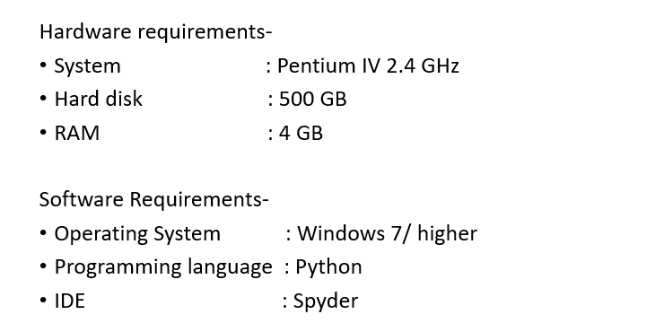
REQUIREMENTS
Hardware and Software Requirements :

Slide 7
Functional Requirements
Computes correlation between dependant and independent variables.
Calculates the efficiency of the implemented algorithm on the dataset.
Non-functional Requirements
Improved accuracy
Improved performance

Slide 8
BLOCK DIAGRAM
PATIENT
DATA FORMATION
TRAINING DATA
TESTING DATA
LOGISTIC REGRESSION
RESULT EFFICIENCY

Slide 9
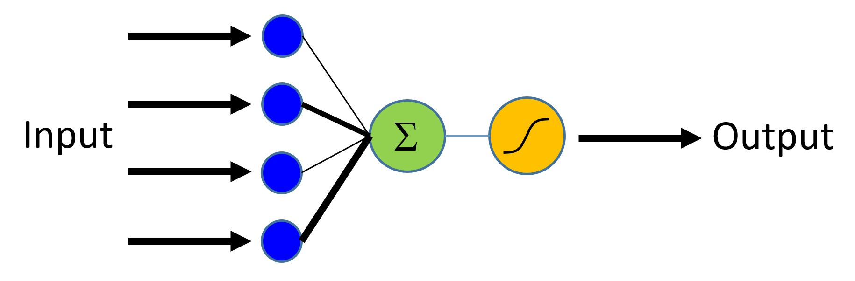
IMPLEMENTATION
Working of Logistic Regression Model

Slide 10



Libraries Used :
Pandas – It provides 2 powerful data structures: Series(1-dimension) and DataFrames(2-dimensions) which makes working with ‘relational’ and ‘labelled’ data easy and intuitive.
Matplotlib – It is a plotting library for python programming language.
Scikit-learn – It is a free software machine learning library for python programming language.

Slide 11
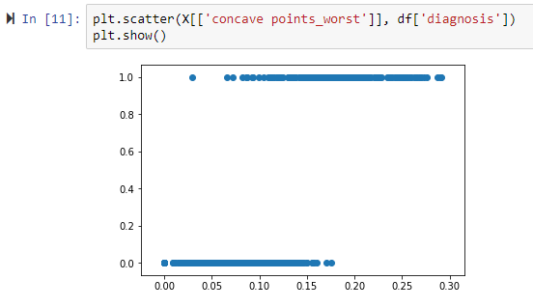
RESULT ANALYSIS
Using Logistic Regression for the breast cancer dataset, the training set accuracy came out to be 96.044% and the testing set accuracy came out to be 95.614% .
GRAPH-

Slide 12
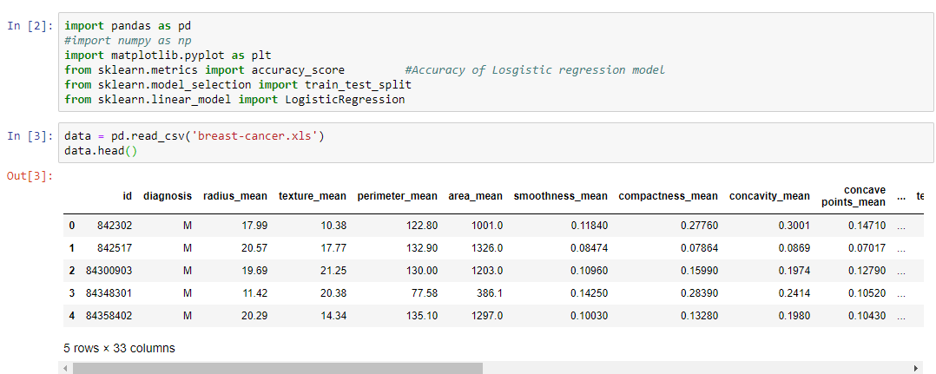
SNAPSHOTS :
Fig 1: Importing the required libraries and reading the dataset.

Slide 13
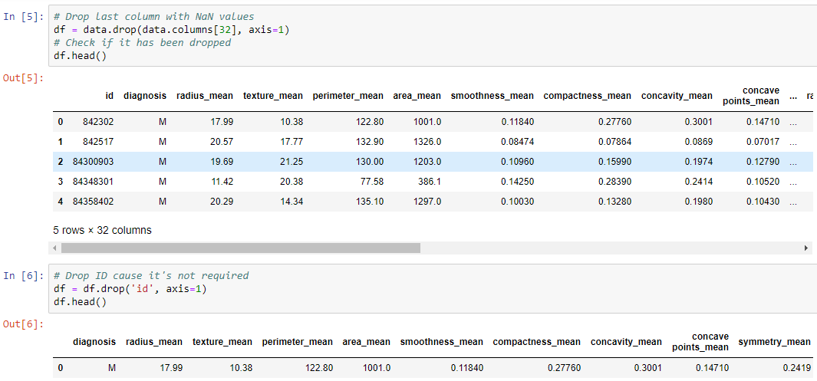
Fig 2: Drop the columns with NaN values along with columns which aren’t required.

Slide 14
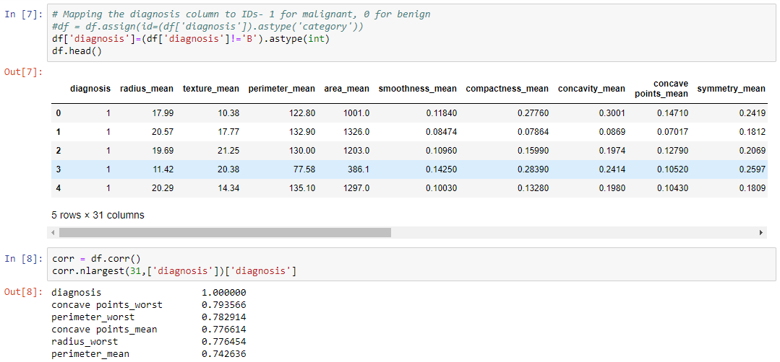
Fig 3: Giving IDs to required columns and finding correlational coefficients.

Slide 15
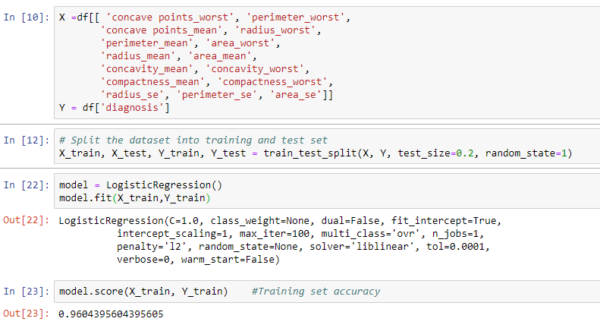
Fig 4: Splitting the data into training set and testing set. Applying Logistic regression model and finding accuracy of the model.

Slide 16
CONCLUSION AND FUTURE WORK
Logistic Regression is better than SVM in accuracy.
KNN, Naïve Bayes and Random Forest algorithms were found to be more accurate than Logistic Regression.
The future work would include making a thorough of all machine learning techniques and finding the one which fits this problem statement the best.

Slide 17
REFERENCES
https://www.researchgate.net/publication/311950799_Analysis_of_the_Wisconsin_Breast_Cancer_Dataset_and_Machine_Learning_for_Breast_Cancer_Detection
https://www.slideshare.net/esatjournals/breast-cancer-diagnosis-and-recurrence-prediction-using-machine-learning-techniques

Slide 18

PROJECT SETUP AND DEMONSTRATION

Slide 19
Thank You!!!

